Slide 1

Day 4 – Software Carpentries
Alexander Garzón

Slide 2
Code of conduct
In order to foster a positive and professional learning environment we encourage the following kinds of behaviours in all platforms and events:
Use welcoming and inclusive language
Be respectful of different viewpoints and experiences
Gracefully accept constructive criticism
Focus on what is best for the community
Show courtesy and respect towards other community members
If you believe someone is violating the Code of Conduct, we ask that you report it.

Slide 3

Why version control?
Who can relate with the following development of files?
  Assignment.docx
  Assignment 2.docx
  Assignment 2 – Copy.docx
  Assignment Final.docx
  Assignment Final Final.docx
  Assignment FINAL.docx
Who has used a collaborative document (e.g.Google docs, Colab)?

Slide 4
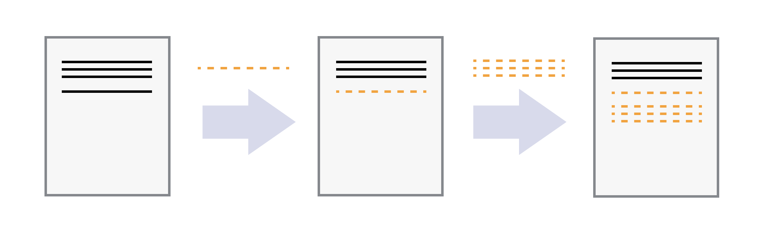
Changes

Slide 5
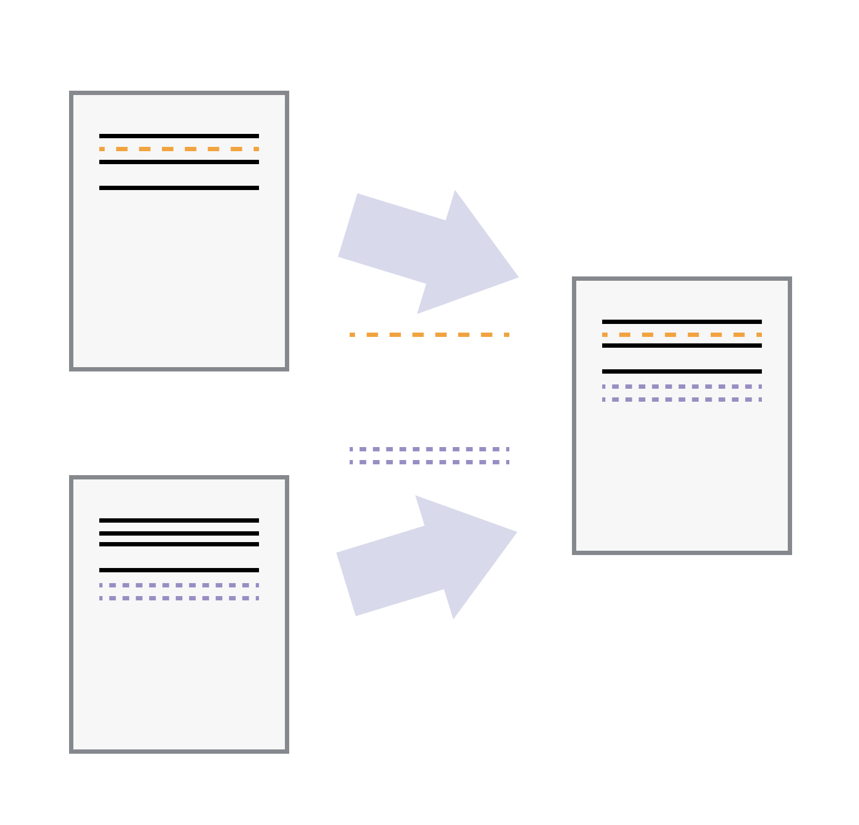
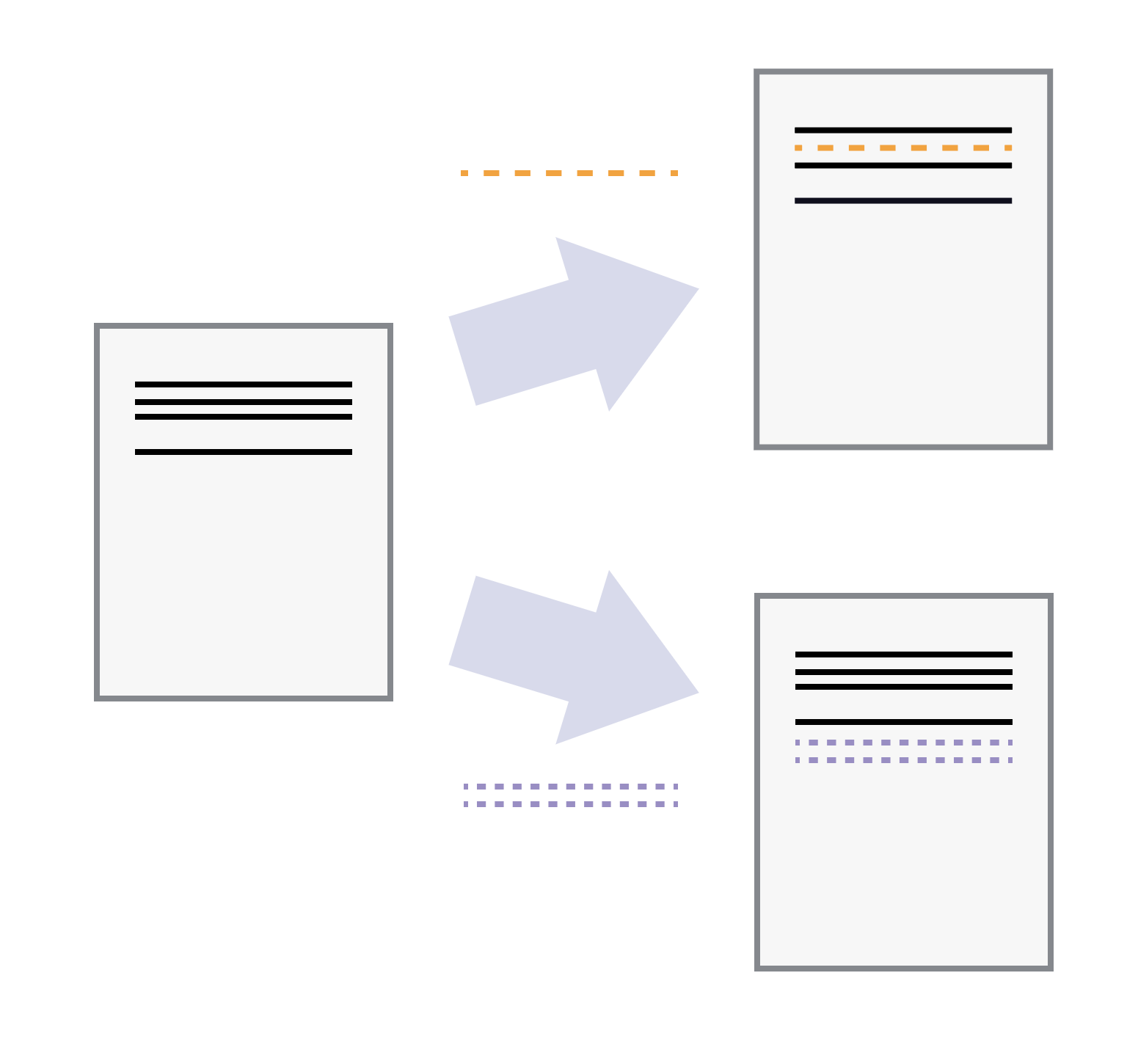
Versions and collaboration

Slide 6

What is Git?
Git is the most used version control system.
  More than 90% of software projects around the world use Git.
It is free, open source, fast and scalable.
It was created in 2005 by Linus Torvalds
  The same creator of Linux OS.
It keeps track of the entire history of a project and allows collaboration of any size.
  Git + GitHub(Gitlab)

Slide 7

What is GitHub?
Developer platform
    https://github.com
It allows developers to
  create,
  store,
  manage and
  share their code.
      Here, we store our project histories.
      Other alternatives are Bitbucket or GitLab

Slide 8




Today’s agenda
1. Local set up and basics
2. Basics and remote set up
3. Collaboration
Celebration!

Slide 9
“Version control might be the most important topic we teach, but Git is definitely the most complicated tool”

Slide 10
Jargon alert!
pull
commit
HEAD
config
cherry-pick
init
repository
fetch
merge
push
conflict
ammend
hash
branch
clone
GitHub
reset
git
stash
log
revert
ssh
show
add
diff
checkout
fork
remote
origin

Slide 11
Jargon alert!
Set up
History
Remote
repository
init
log
revert
diff
ammend
config
remote
show
cherry-pick
clone
Tracking changes
stash
add
conflict
fetch
reset
commit
pull
fork
HEAD
push
git
…
branch
repository
checkout
hash
GitHub
ssh
Block 1
Block 2
merge
origin
Block 3

Slide 12
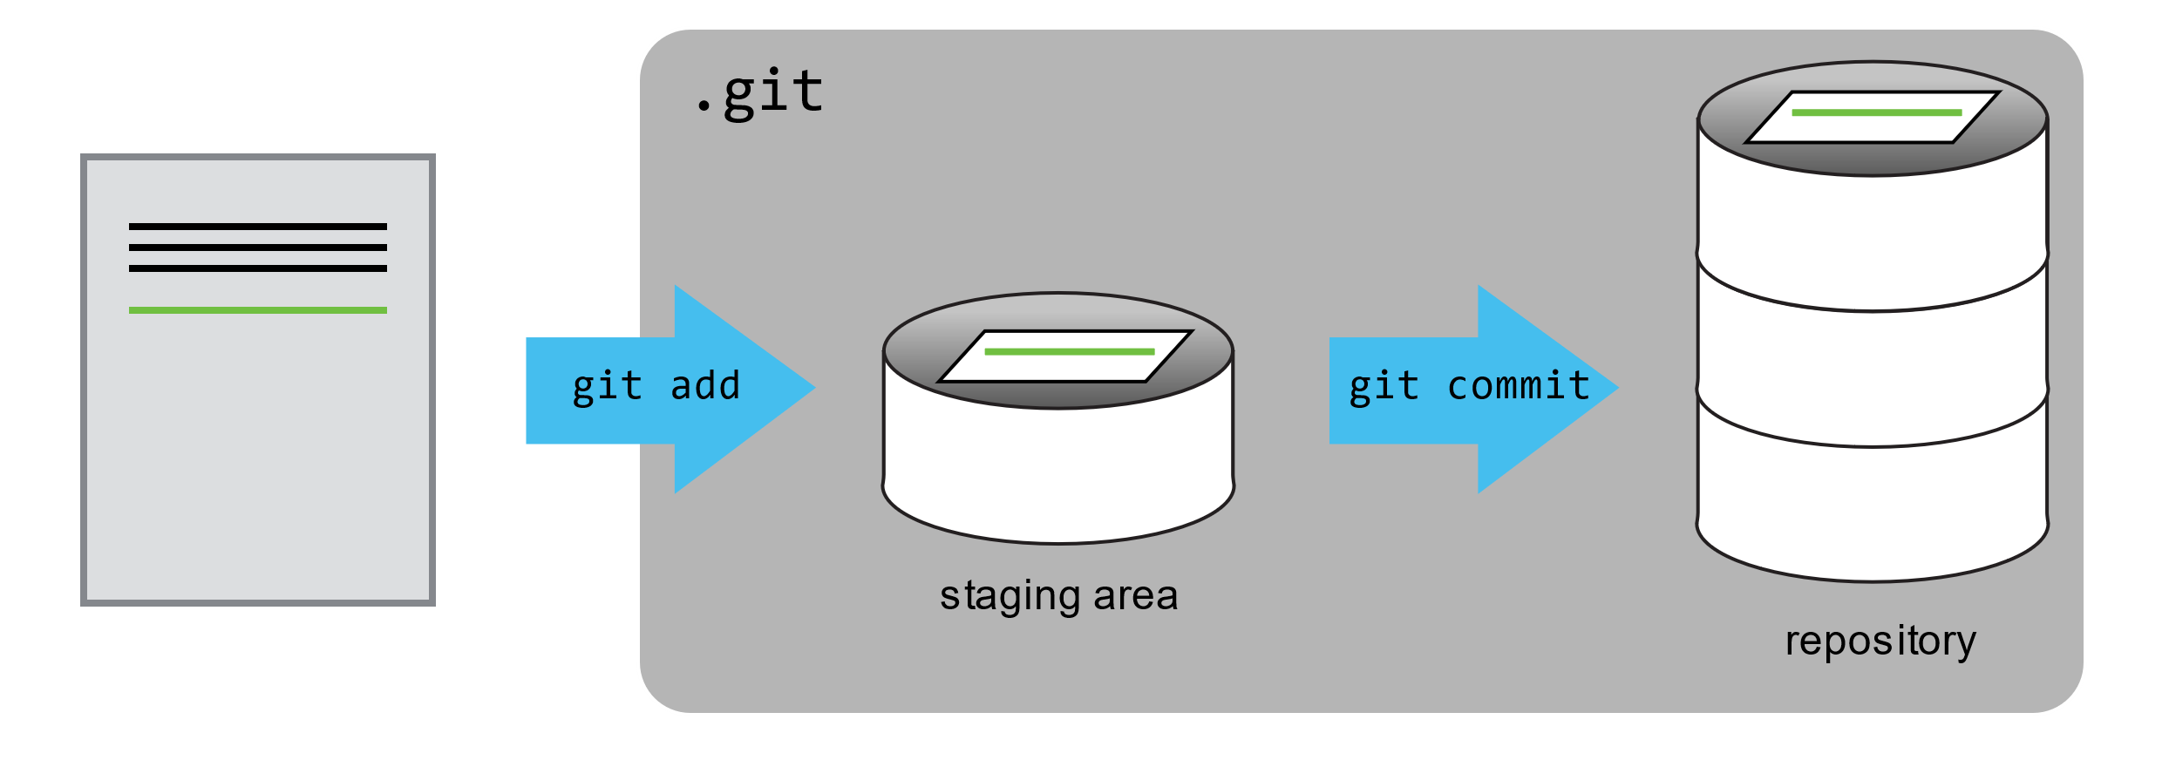

Basics
Working directory
Repository

Slide 13

Commits
D83m9c
nv8si29
o10sx0i
Snapshot of the folder
Author
Email
Date
Message (an explanation)

Slide 14
Let’s Git!

Slide 15
Setting up Git
git config --global user.name "Vlad Dracula"
git config --global user.email vlad@tran.sylvan.ia
git config --global init.defaultBranch main
git config –list
git help

Slide 16
Creating a repository
git init
git status
git checkout -b main

Slide 17
Tracking Changes
Staging area
Repository
Working directory

Slide 18
Exercise 1
Create a new text file.
Write some additional lines to your file.
Add the changes to the staging area.
Commit them.
Exercise 2
Notes
Run git status after every step.
Run git log after step 3.
Repeat the exercise a couple of times
Delete some lines from your file.
Add the changes to the staging area.
Commit them.
Exercise 3
Create a new file and add some text.
Add the changes to the staging area.
Commit them.

Slide 19
Break

Slide 20
Key takeaways
We can see our changes with
  git diff
  git log
Git uses the pattern
  git <verb> <--options>
For setting up your name and email
  git config --global user.name “your name”
  git config --global user.email your@email.com
To initialize a repository, we use git init
We can commit our changes with
  git add
  git commit

Slide 21
Today’s agenda
1. Local set up and basics
2. Basics and remote set up
3. Collaboration
Celebration!

Slide 22
Basics II
Part 2
How to see the difference with previous versions
How to show the changes introduced in a commit
How to ignore files
Guide to GitHub
How to connect your local computer to the remote storage of GitHub
  How to set up your SSH keys
Remote set up

Slide 23
Time travel
HEAD~2
HEAD~1
HEAD
D83m9c
nv8si29
o10sx0i
Commit

Slide 24
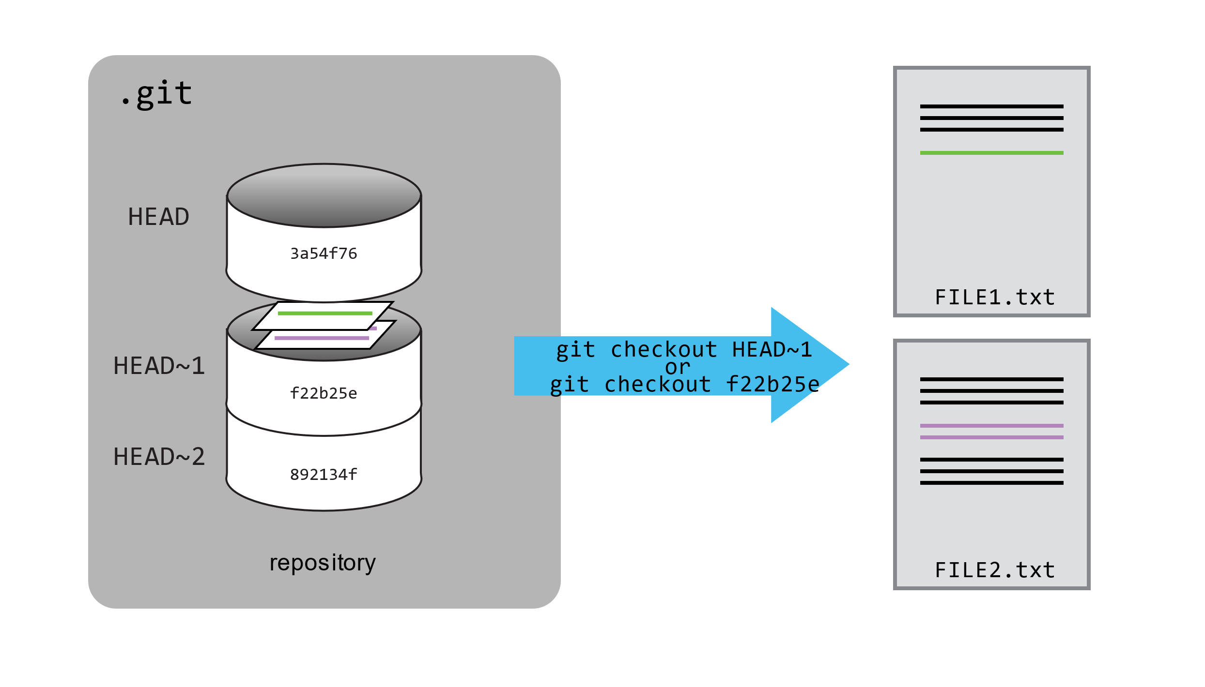
git checkout

Slide 25
Exercise 4 – The alphabet
Create a new text file called alphabet.txt
Modify the file by adding the letter “A”.
Add and commit those changes.
Modify the file by adding the letter “B”.
Add and commit those changes.
Modify the file by adding the letter “C”.
Add and commit those changes.
Recover the versión of the file that only had “A” in it.

Slide 26
Key takeaways
git diff displays differences between commits.
git checkout recovers old versions of files.
The .gitignore file tells Git what files to ignore.

Slide 27


Let’s create a remote repository!
D83m9c
nv8si29
o10sx0i
D83m9c
nv8si29
o10sx0i

Slide 28
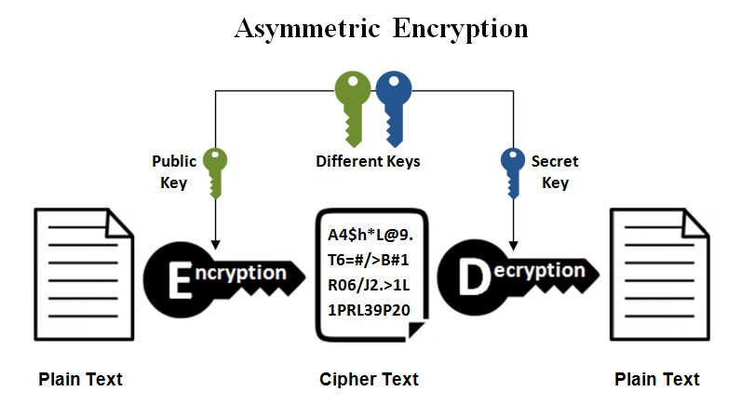
SSH Keys
Open Git Bash.
ssh-keygen -t ed25519 -C "your_email@example.com"
  > Enter passphrase (empty for no passphrase): [Type a passphrase]
  > Enter same passphrase again: [Type passphrase again]
  eval "$(ssh-agent -s)“
  ssh-add ~/.ssh/id_ed25519
Best way, search for the documentation:
Generating a new SSH key and adding it to the ssh-agent - GitHub Docs

Slide 29
Break

Slide 30
Today’s agenda
1. Local set up and basics
2. Basics and remote set up
3. Collaboration
Celebration!

Slide 31
Let’s learn about
GitHub!
Notes:
Version Control with Git: Remotes in GitHub (swcarpentry.github.io)
Create a repository,

Slide 32
D83m9c
nv8si29
o10sx0i
D83m9c
nv8si29
o10sx0i

Slide 33

D83m9c
nv8si29
o10sx0i
git clone
D83m9c
nv8si29
o10sx0i
D83m9c
nv8si29
o10sx0i
Notes:
Demo: Version Control with Git: Collaborating (swcarpentry.github.io)

Slide 34
Git and GitHub
git push origin main
Notes:
Version Control with Git: Remotes in GitHub (swcarpentry.github.io)

Slide 35
Collaboration

Slide 36
Exercise 5
Add your colleague(s) as collaborator(s)
Add some text lines in one of your local files.
Add and commit your changes
Push your changes
Fetch the changes
Clone the repository to your local computer
Make a new file and add some text lines.
Add and commit your changes
Push your changes
Fetch the changes
6. Pull the changes

Slide 37
Key takeways
A local Git repository can be connected to one or more remote repositories.
Use the SSH protocol to connect to remote repositories.
git push copies changes from a local repository to a remote repository.
git pull copies changes from a remote repository to a local repository.
git clone copies a remote repository to create a local repository with a remote called origin automatically set up.

Slide 38
Celebration time!

Slide 39
Exploring history
Version Control with Git: Exploring History (swcarpentry.github.io)

Slide 40
Ignoring things
Version Control with Git: Ignoring Things (swcarpentry.github.io)

Slide 41
Remotes in GitHub
Version Control with Git: Remotes in GitHub (swcarpentry.github.io)

